Slide 1
WARNING
These slides are not optimized for printing or exam preparation. These are for lecture delivery only.
These slides contain a lot of animations. For optimal results, watch in slideshow mode.

Slide 2
CS2103/T Week 7
[Sep, 2024]
[35m]
Which of these sequences of interactions are possible?
A
ABCD
ACBDEF
ACBDFE
Shorter due to the tP briefing
:Box
foo()
A
Similar to an exam question
opt [valid]
:Bottle
B
C
D
par
E
F

Slide 3
Answer this in the Canvas quiz
1
Yes
No
Is this sequence possible? A
:Box
foo()
A
opt [valid]
:Bottle
B
C
D
par
E
F

Slide 4
2
Yes
No
Is this sequence possible? ABCD
:Box
foo()
A
opt [valid]
:Bottle
B
C
D
par
E
F

Slide 5
3
Yes
No
Is this sequence possible? ACBDEF
:Box
foo()
A
opt [valid]
:Bottle
B
C
D
par
E
F

Slide 6
4
Yes
No
Is this sequence possible? ACBDFE
:Box
foo()
A
opt [valid]
:Bottle
B
C
D
par
E
F

Slide 7
5
How to show exceptions, try blocks, lambdas, recursion in a sequence diagrams?
[ ] Don’t bother.
[ ] Not the purpose of SDs.
[ ] Not in the scope of this course.
[ ] It’s impossible.
Use a UML Note when other notations are not enough
Or use code/pseudo-code
In our context, UML models are not meant to be ‘code as diagrams’. They usually,
capture only one aspect,
capture only things relevant to the purpose
should not result in very complicated diagrams

Slide 8
Which are true?
[ ] logging is like a CCTV camera system
[ ] logging is like a black-box of an air plane
[ ] assertions are like smoke alarms
[ ] exceptions are like safety nets for acrobats

Slide 9
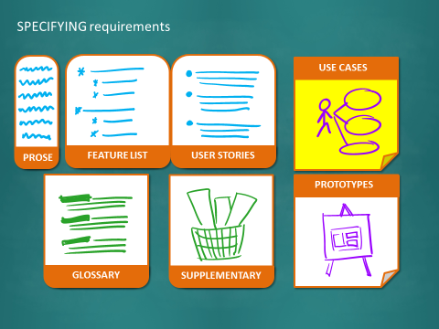
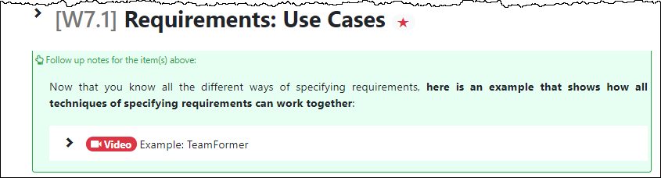

Slide 10
Which of these is NOT a Non-Functional Requirement?
The code should be open source.
The product should prevent unlawful usage.
Admin user can delete any other account.
All user actions must be logged.

Slide 11
iP (greenfield): grow design from scratch
tP (brownfield): evolve given design
What if you have to come up with your own design for a team project?

Slide 12
To help make design decisions in the tP

Slide 14
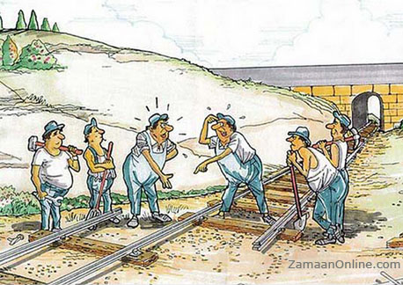

Slide 15


Slide 16
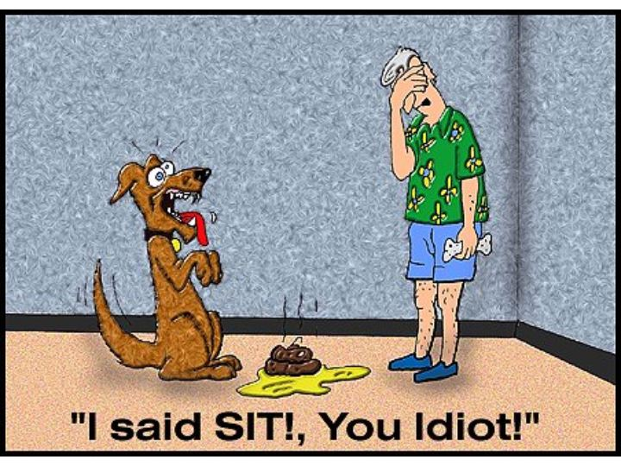
Due to miscom

Slide 18
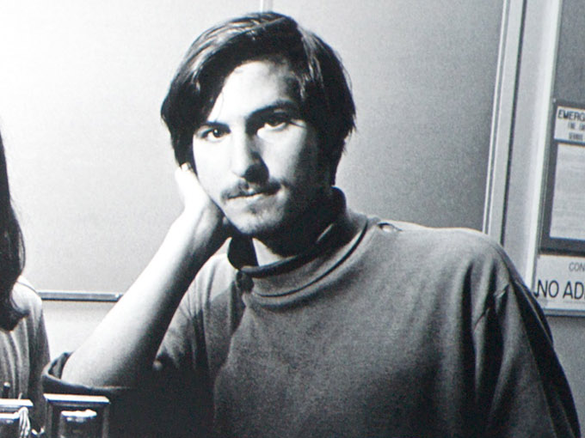
If you eat fruits only, there is no need to clean your body. The body cleans itself.
Notes:
Co-workers of young Steve Jobs complained because he did not shower.

Slide 19
Young Steve Jobs thought that by eating only fruits the need to shower was eliminated, so he stopped showering. When he worked for Atari, his co-workers complained about his body odor, and his boss had to assign him the night shift so that he wouldn't need to interact with other people.
Notes:
Co-workers of young Steve Jobs complained because he did not shower.

Slide 20
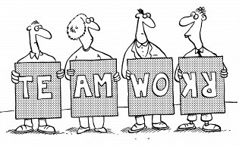
A project cannot fail because of one person.

Slide 21
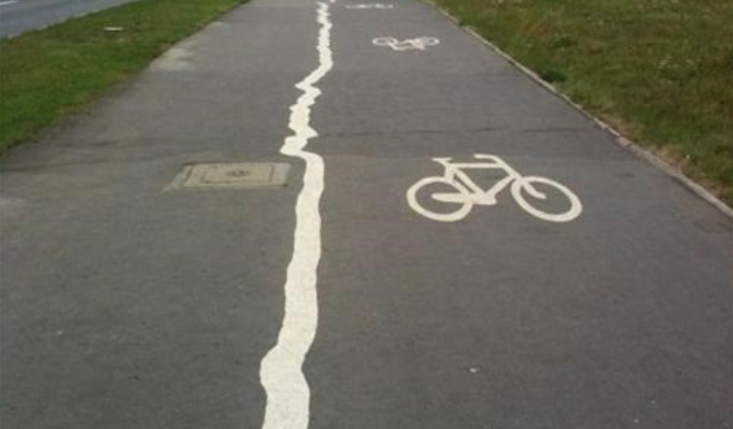
Its better to do less work but of better quality than to do more work but of poor quality
Never is better than late (?)

Slide 22
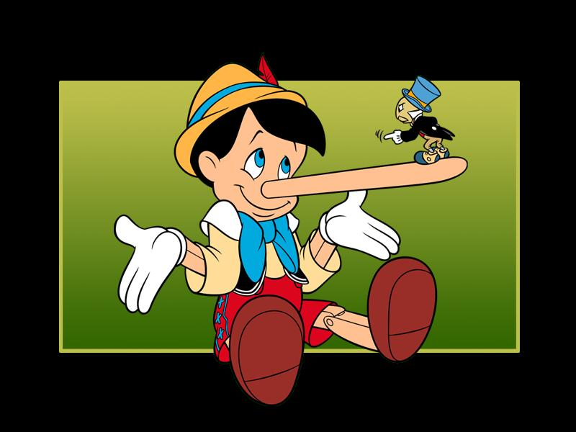
Most of all, be sincere.

Slide 23
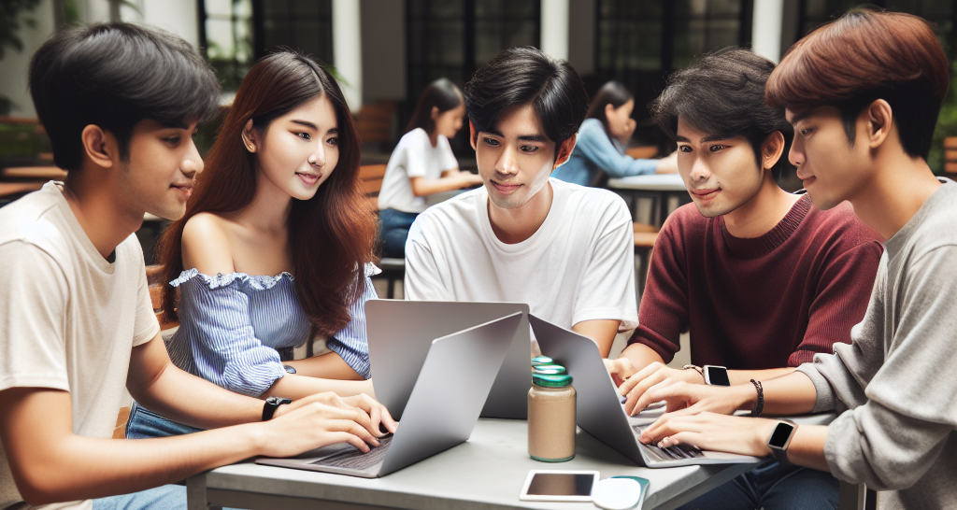
Image: AI-generated

Slide 24
